Slide 1
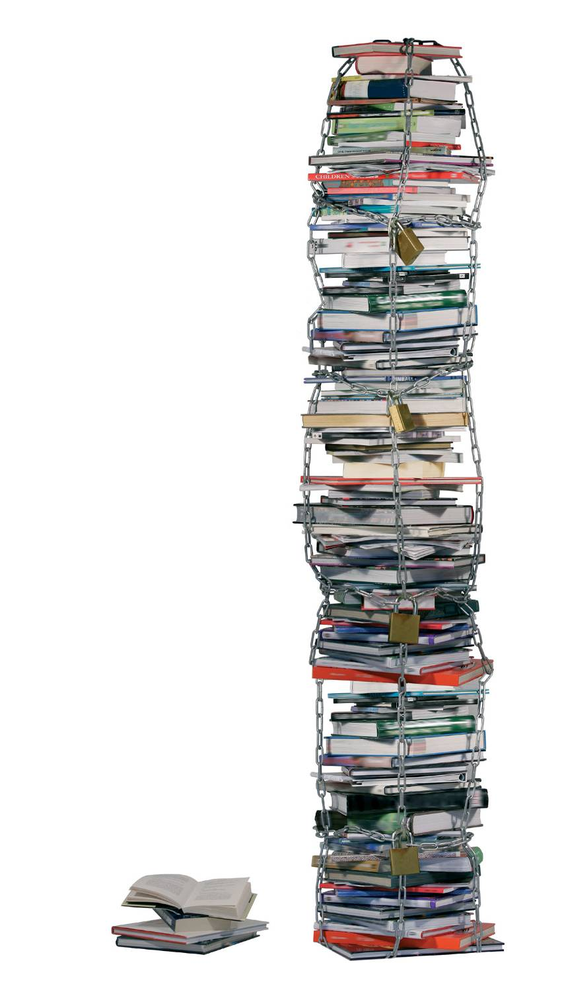
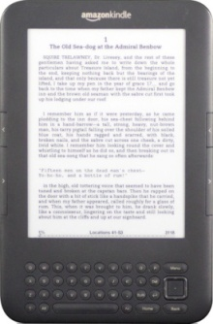


Swedish Daisy Consortium
10 Year Anniversary
Ending the Book Famine
How does the WIPO treaty Help?
Stephen King
President , Daisy Consortium

Slide 2
God Morgon
Svenska Daisykonsortiet!

Slide 3
Sweden Has Proud History as Founder of Daisy Consortium
Consortium original agreement drafted here in Stockholm in 1996: I am proud to have been there
Sweden, UK, Spain, Japan, Switzerland, Netherlands
First President Inger Beckman Hirschfeldt
Great Visionaries: Lars Sonnebo, Kjell Hansson
Now Markus Gylling is Chief Technology officer
Consistent strong supporter of global approach, cooperation and rights of people with disabilities

Slide 4
What I will cover
About the book & curriculum famine
The WBU Right to Read advocacy campaign
The WIPO Copyright Treaty: How it helps
Progress made to end the book famine
The DAISY Consortium strategy to end the book famine
Next steps
How you can help

Slide 5

Since Caxton people with print disability denied access

Slide 6

Print disabled learners denied access to curriculum

Slide 7

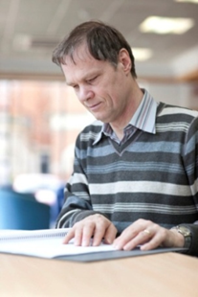
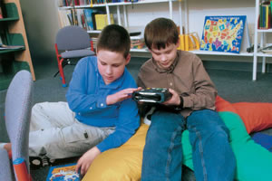

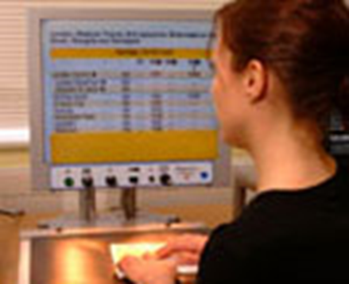
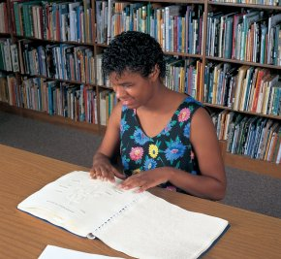
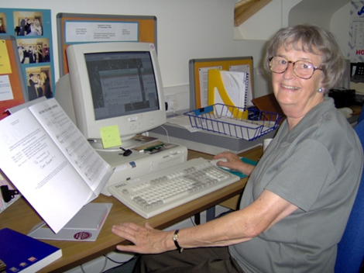
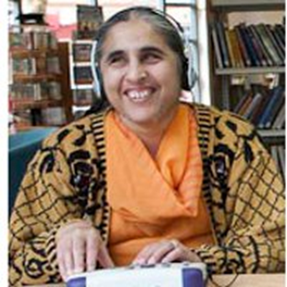
Libraries for the Blind have helped
Reading with eyes ears & fingers

Slide 8
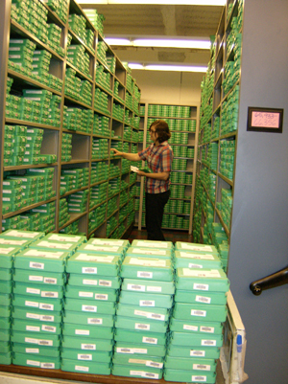

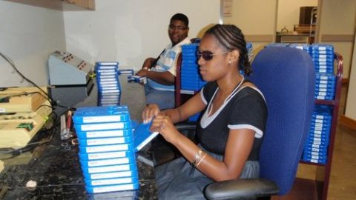
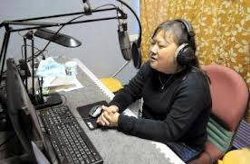
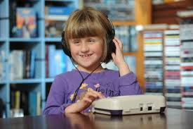
But libraries can’t keep up
Explosion of publishing
Making Braille, talking books, large print is expensive
Only 5% of books available in accessible formats in best performing countries
Developing countries lack basic infrastructure

Slide 9


The Right to Read 2000-2013
"Less than 5% of books are available in any accessible format"
"It’s a book famine"
"We want the right to read the same book at the same time, price and place as everyone else"

Slide 10



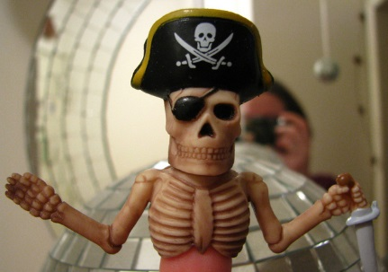


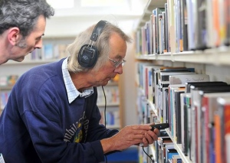
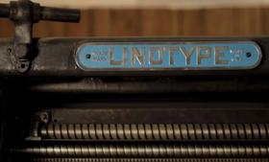
WBU Right to Read Campaign
Barriers to more accessible books
Money
Copyright
Reading & publishing technology

Slide 11
WBU Right to Read Strategy
End the book famine by
National campaigns for more money for reading
Global campaign via WIPO on Copyright
Develop reading & publishing Technology
Promote new model of inclusive publishing

Slide 12








Partnership to end the book famine
Money
  Local & Regional members
Copyright
  IFLA, Daisy Consortium, Civil society
Inclusive publishing
  Daisy Consortium, Publishing industry
The voice of blind and
partially sighted people in Europe

Slide 13
WBU advocacy for more money
Some successes some problems
Global
  UN Convention on Rights of Persons with Disabilities; Accessibility, education, livelihood
Regional
  EU research but legislation like accessibility act stuck
National
  Canada: Government funding for library services
  Scandinavia: Continued priority for accessibility
  India: Increased Govt attention & legislation

Slide 14
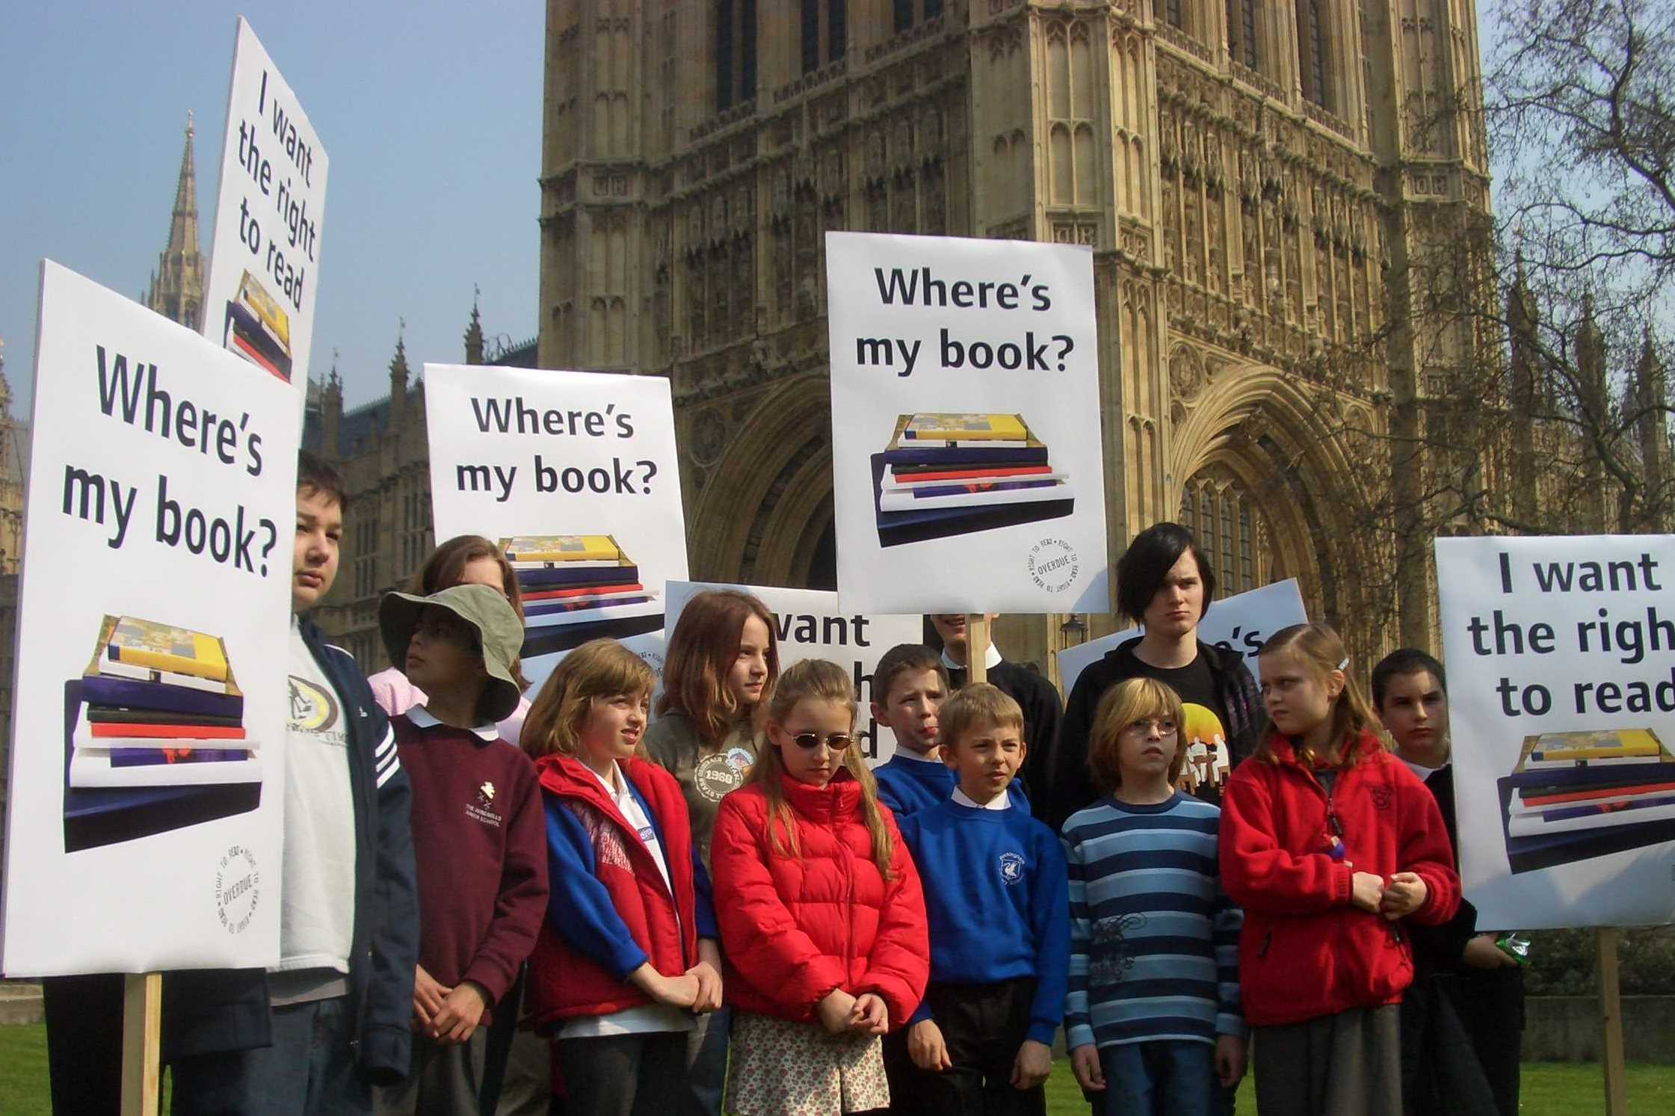
Money: UK School Children ask Parliament
“Where’s my book?”

Slide 15
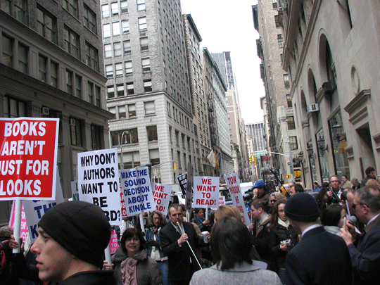

Slide 16




WBU Copyright campaign
“If a book is available somewhere in a format I can read I can get hold of it easily and quickly”
Break Copyright barriers
  Recognising its not the only barrier
Sharing expensive accessible formats
Global Library of accessible formats

Slide 17


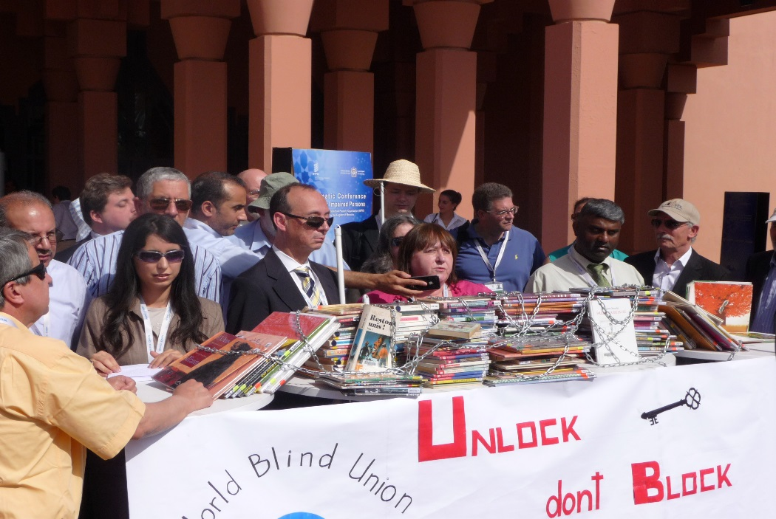
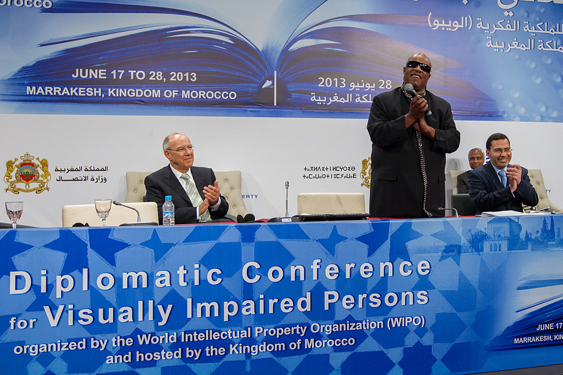
Copyright Treaty June 2013
Success in Morocco

Slide 18
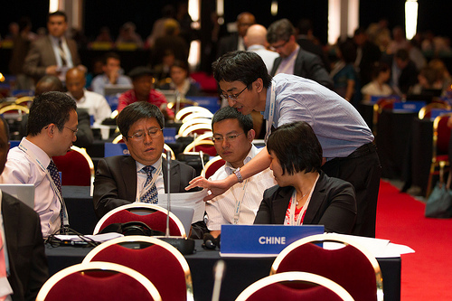
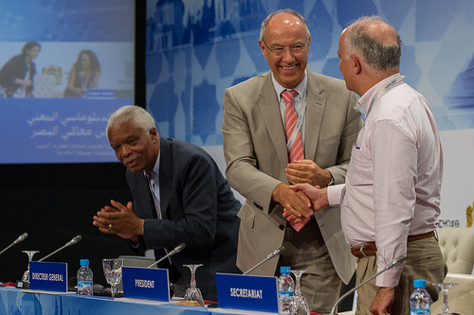

Copyright Treaty June 2013
Next steps
Treaty signed by 61 countries (At 27 Nov 13)
  China, Chile, USA, UK, Korea, Switzerland, Denmark, (Not Sweden yet, but EU announced it will)
National laws need updating to compliance
Ratification is next:

Slide 19
What does WIPO Treaty Mean?
(after ratification which may take 5 + years)
It does not solve the book famine on its own
It Enables “Enhanced Accessibility books” produced using a copyright exception in one country to be supplied to a user or “Authorised Entity” in another country where there is a copyright exception law.
  Business to Business or Business to Consumer
Enables global market place for accessible formats
Still need business arrangements & Infrastructure

Slide 20

How does Treaty Help Sweden?
“What I want to read”, not what’s available here
    Enables access to global culture & learning in accessible formats
    Support minorities who want to read own language
    Support people learning languages and studying
    Supports global (economic) development
    Better, richer libraries & more cost effective
    People with print disabilities better equipped for out globalised world
BUT: The Marrakesh treaty is just the start: There is much more to do

Slide 21
Does WIPO Treaty End the book famine?
No! Still need to deliver other projects
Money & resources
    Need to ensure benefits people in developing countries
    Maintain funding for access enhancing industry
Treaty Implementation in 200 countries
    Need copyright law with exception in each country
    5 year + programme: but good momentum
Develop reading & publishing Technology
    Reading with eyes ears & fingers is easy & affordable
    Publishing captures accessibility mark-up & features
Promote new model of inclusive publishing

Slide 22
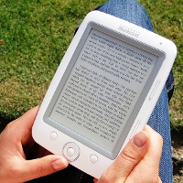
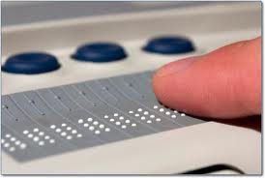
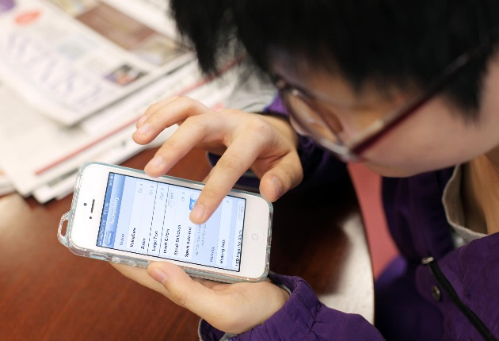

Reading & Publishing Technology
Great Progress!
The E-book revolution
The growth of mobile devices
The speech synthesiser revolution
Low cost braille display project

Slide 23

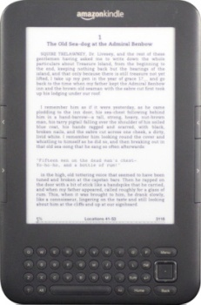
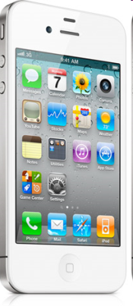
The e-book revolution
People with print disabilities are increasingly able to enjoy the same book at the same price and place as everyone else"
"But there is much more to do to end the book famine."
Stephen King, Helsinki June 2012

Slide 24
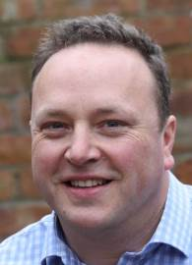

Swedish DAISY Consortium annual conference
Stockholm 28-29 November 2103
“eBooks offer choices for Print Disabled People”
Richard Orme, UK
digital accessibility
inclusion strategy
corporate responsibility
rorme@outlook.com

Slide 25
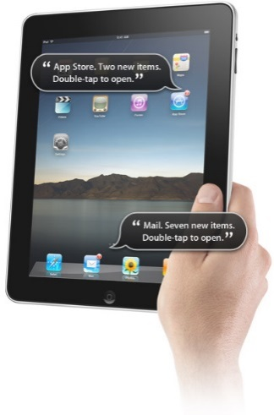
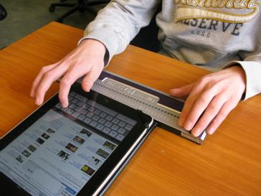
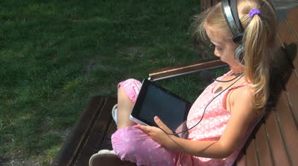
Many people can benefit now!
You will have heard from Richard Orme about transformation in access to reading in English
For people with low vision reading is transformed
For ears & touch readers "If you've experienced a famine, you will relish mouldy bread"
A better reading experience needed

Slide 26
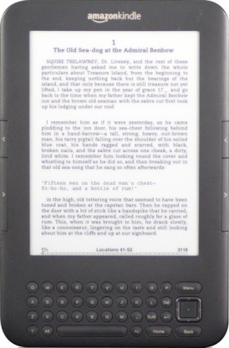

UK Research published July 13
E Books transform access
7% of all books available in UK accessible by eyes, ears & fingers (Up from 5% in 2004)
84% of top 1000 books sold in 2012 are e-books, readable by eyes, ears & fingers. (Up from 54% 2010 & 74% in 2011)
Of top 1000 99% adult fiction, 77% Non fiction & 43% Children's readable by eyes, ears & fingers

Slide 27
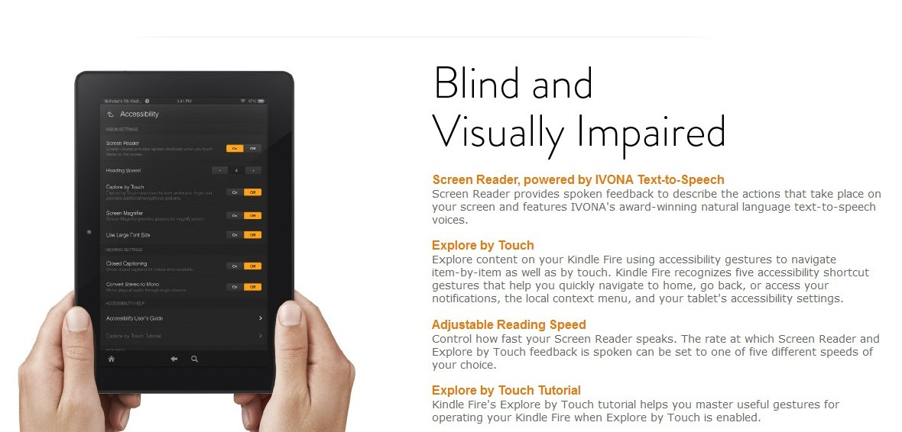
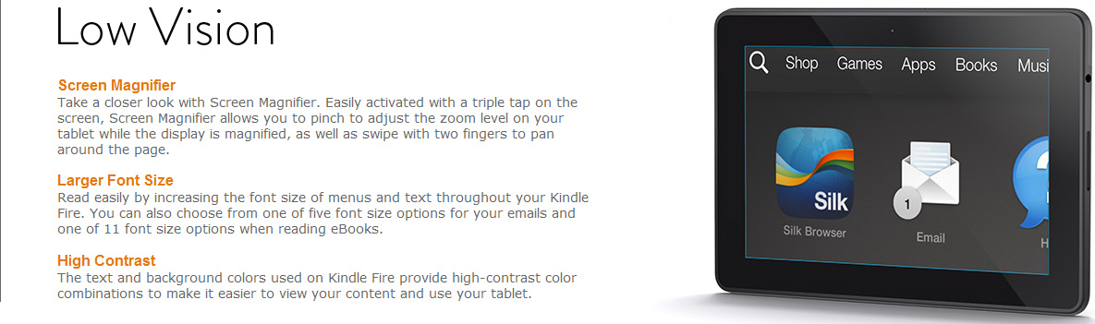
Latest Kindle Fire
Offers accessibility features built in

Slide 28
Great Progress-But no one delivers great navigation: Yet!
Novel reading is OK: If you have knowledge
Navigating around a problem
Non fiction, news and education a problem
People need skills and confidence
But fantastic progress In English & few languages
Problem of lack of speech synthesis for many languages

Slide 29
Still much to do… Many publishing and reading problems still to solve
How are the DAISY Consortium involved?

Slide 30


Promoting a new model of Inclusive publishing
The Daisy Consortium and its members are leading
    Supported by WBU, IFLA, IPA & WIPO
We have a proud heritage of improving reading
    Talking books
    E-Books
Now we are focused on helping global publishing industry change
Supporting our global network of “authorised entities” and producers to integrate & change

Slide 31

Publishing is a Global Business
Daisy Consortium is Global

Slide 32
Our DAISY Consortium Vision
People have equal access to information and knowledge, regardless of disabilities
Our Mission
Working to create the best way to read and publish,
for everybody, in the 21st century
By delivering global partnerships ... that build a more effective solution for everyone.
Committed to a common mission & vision. Coordinating resources to deliver global change

Slide 33

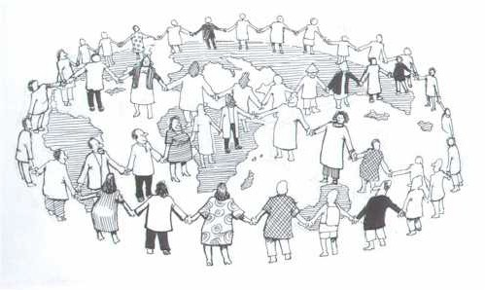


Global partnerships
Solving the book famine

Slide 34
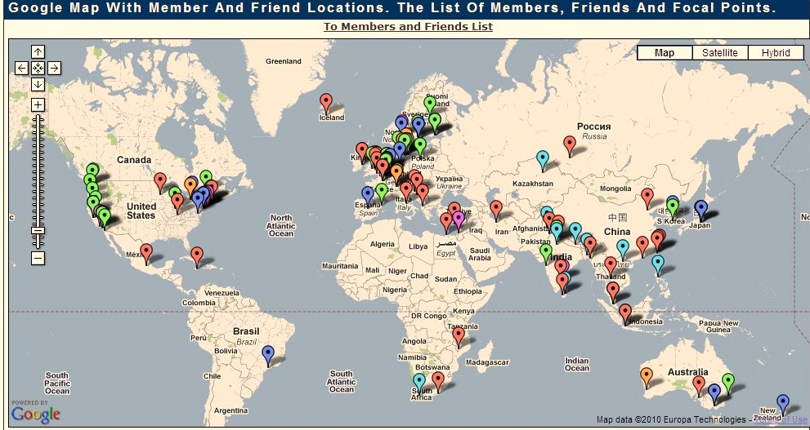
Daisy member worldwide
Libraries for blind & Friends

Slide 35
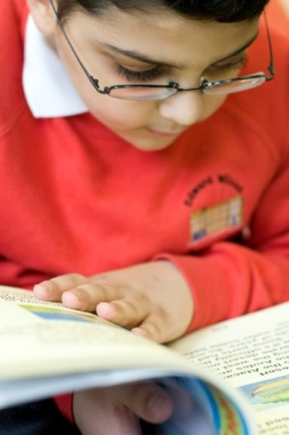
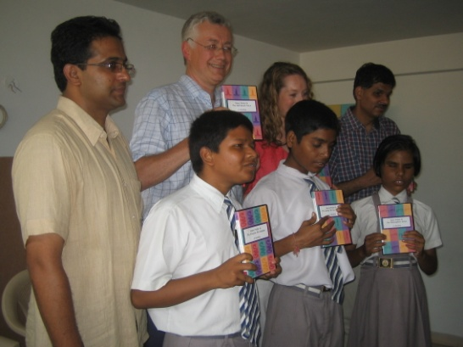

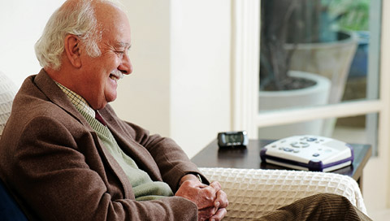


Our goal is confident readers reading what they want, when they want with eyes, ears or fingers

Slide 36
Daisy Vision for reading in 21st C
E-books readable on low cost devices (Phone)
    Local language speech synthesis & screen readers
    Low cost braille display: Transforming Braille
    Cheap tablets as an E-slate for many
    Specialist devices for heavy users & special needs
Libraries enhance access to some e-book
    Picture descriptions, diagrams, maths etc
Direct production of Braille from e-books
Global catalogue of access enhanced materials
Access enhanced materials available worldwide

Slide 37
Inclusive publishing
From consumer point of view
I can discover access features of any book easily
    From bookshop, library, internet, Tigar catalogue
    Most books have the access features I need
I get books from same shop or library as others
    Read on my phone, tablet or specialised device with eyes, ears or fingers
Some books I need enhanced access features
    Discover whats available from TIGAR catalogue
    Easily order from local or global authorised entity (University, school, library, shop, online service provider etc)

Slide 38

New model of Inclusive Publishing
Increasing numbers of e-books that have built in accessibility: Inbuilt access publication
  IDPF partnership
  E-pub 3 standard development
  Work with publishing tools tech companies
  Develop better meta data on access features
Improved efficiency where publications need access enhanced: Access enhanced material
  Link libraries for blind into publisher workflow
  Obi,Tobi & pipeline production tools
  Coordinating production of access enhancement

Slide 39


Inbuilt accessibility: Standard
E-book read by eyes ears or fingers

Slide 40


Enhanced accessibility version
Picture descriptions, complex layout
Simplified for learning disability
Economically derived from standard e-book

Slide 41

Daisy consortium Strategy
Helping libraries for the blind improve, change & cooperate
Better ways to read
    Work with Tech co’s on accessibility features
Better ways to publish
    Work with industry on inclusive publishing
    Develop meta data on access features
Sharing accessible versions worldwide
    TIGAR project, Global library, Bookshare etc
Skills and knowledge development
    Publishing Industry, providers & consumers

Slide 42

Sharing Enhanced Accessibility versions worldwide
TIGAR Network project
  Trusted Intermediaries Global Accessible Resources
“If a book is available somewhere in a format I can read I can get hold of it easily and quickly”
TIGAR Project sponsored by WIPO: Will now change
Global catalogue & framework for crossing borders

Slide 43
Next steps to End the book famine
Spread accessibility benefits of e-books
  Skills development + missing speech synthesis
Bring benefits of e-books to braille users
  Complete Transforming Braille project
Get wide adoption of E-pub 3 standard
  More books with built in accessibility
  Better meta data on access features
Implement new copyright treaty in 200 countries
Develop TIGAR Global network & global catalogue
Spread skills, knowledge and access technology

Slide 44
Daisy Consortium of Sweden
You can help!
Continue to support the Daisy Consortium
Contribute your Skills and knowledge
Promote ratification of Marrakesh Treaty
Promote inclusive publishing
  More e-books with accessibility built in
  Better meta data on access features
  Efficient access enhancement where necessary
Share your access enhanced books worldwide
Spread the knowledge of new ways to read

Slide 45

Together we can
Solve the book famine
Tack så mycket
Stephen King
President Daisy Consortium: President@Daisy.org

